Slide 1

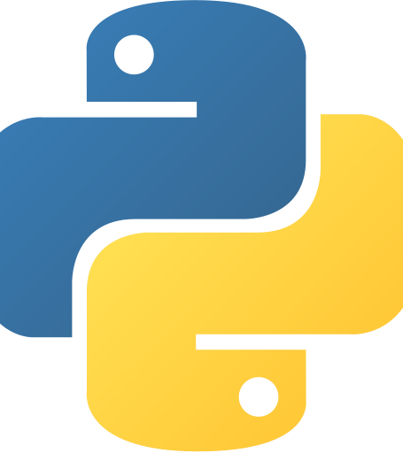
Topics in Programming Languages
Max Gelmadin & Lior Fradin

Slide 2
Python
Object Oriented
Procedural
Functional
Structured
Dynamically Typed
Strongly Typed
Garbage Collected

Slide 3
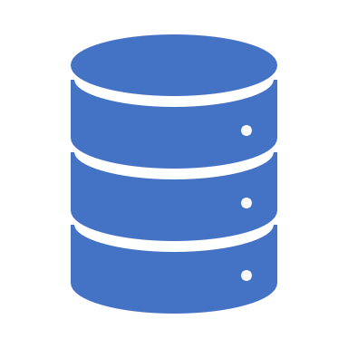
Database
Django supports numerous databases:
PostgreSQL
MariaDB
MySQL
Oracle
SQLite
About SQLite:
SQLite is a relational database management system (RDBMS) contained in a C library. In contrast to many other database management systems, SQLite is not a client–server database engine. Rather, it is embedded into the end program.
Why we decided to use SQLite in this project:
Suitable for basic development and testing
Easy to use
Easily portable
When scalability becomes an issue, Django’s framework allows us very easily migrate to a more advanced database such as MySQL.

Slide 4
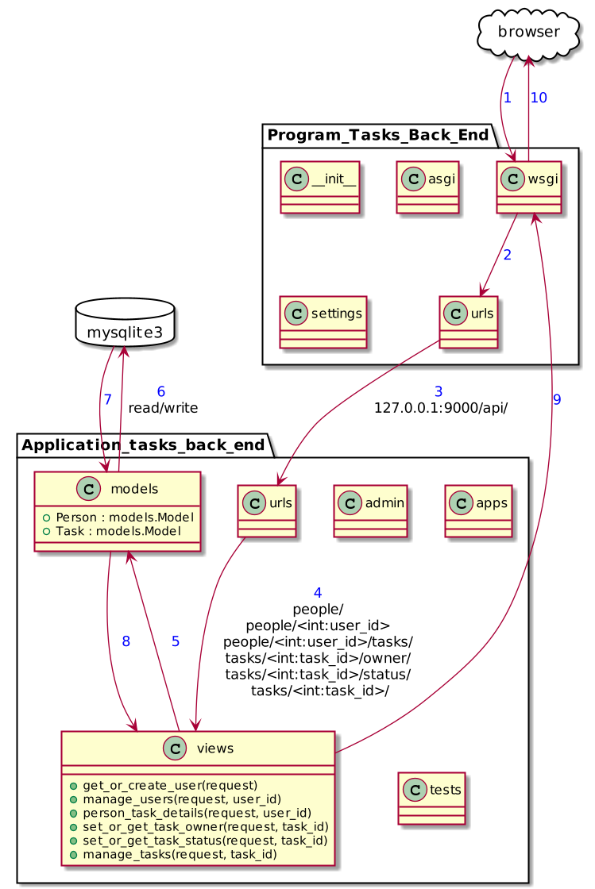
Flowchart of the Project

